Slide 1


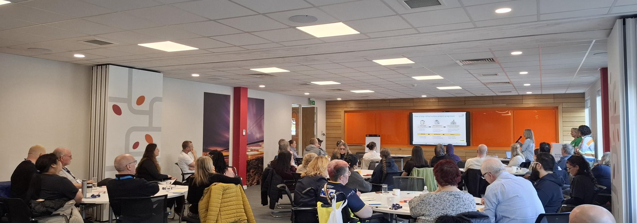
Citizen Panel
Wave 3 report: Spring 2026
Customer insight on understanding the network charge and the East Coast Hydrogen project

Slide 2

Content
Contents
2
2
2
2
Key findings
Consumer context
Communicating the network charge
East Coast Hydrogen project
Appendix
1
2
3
4
5

Slide 3

Background & objectives
3
Background
Northern Gas Networks’ Citizen Panel is a long-standing engagement mechanism for the business, which allows its thinking to be challenged and tested by a broadly representative group of consumers.
In 2025, Blue Marble was appointed to refresh the approach and membership, and support NGN with its delivery.
Three waves of engagement are held each year, comprising:
Full-day workshop with a Workshop Panel;
Depth interviews with an Inclusive Panel.
Wave 3: objectives
Network Charges
Understand how much information customers need about the network charge of the bill and subsequently how best to present and communicate this information on the NGN webpage
Understand what bill information future research participants need and how best to communicate this
East Coast Hydrogen Project*
Gain insight into which drivers for the project have the most support from Members
Understand public information needs at the ‘FEED study’ stage, for planned 2026 engagement
Develop principles for future consultation and engagement
March 2026
*The Inclusive Panel did not engage with this topic

Slide 4
Methodology
4
Citizen Panel
Workshop Panel: 30 attendees
Inclusive Panel: 10 Members
19 retained original Members: bringing informed views
10 recent Members: bringing fresh perspective
1 Young Innovators Council (YIC) transitioner: bridging the gap between NGN’s engagement panels
Members who for a variety of reasons cannot attend an in-person workshop, ensuring inclusivity and diversity
Wave 1
July workshop
Depth interview 1
Wave 2
November workshop
Depth interview 2
Wave 3
March workshop
In-person full day workshop in Leeds
Depth interview 3
60 minute 1-1 online interviews
Findings in this document report on the Citizen Panel as a whole, only distinguishing Inclusive Panel views where they differ
Workshop Panel Quote
Inclusive Panel Quote
For sample details, see appendix

Slide 5
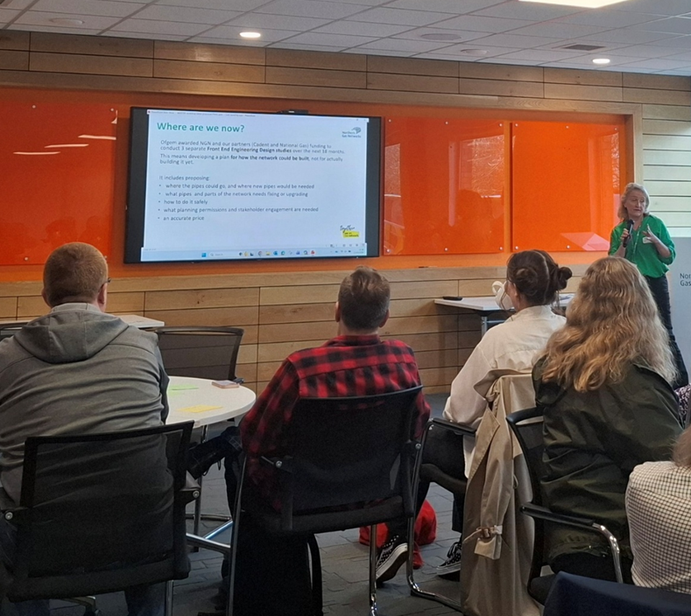
Key findings

Slide 6
Key Findings: Consumer Context
6
In spring 2026, Members express greater concern than ever about cost-of-living pressures across society, anticipating further increases to energy and fuel costs arising from the Iran war.
Linked to this Members are more vocally sceptical of net zero policies. Importantly, this scepticism does not necessarily reflect opposition to environmental goals; rather, it often stems from a lack of trust in large institutions, such as government, to act effectively and a frustration with the onus and costs placed on individuals.
To better understand the range of perspectives among Members and the wider customer base, we have developed a qualitative segmentation based on the views expressed.
These highlight where sentiment differs across customer groups and to help explore the underlying drivers of these attitudes.
These also provide a lens for understanding different customer needs regarding network standing charge communication.
Pressured but eco-conscious
Engaged and stable
Economic insecurity Economic security
Trust in institutions
Struggling and disillusioned
Comfortable but cynical

Slide 7
Key Findings: Communicating Network Charges
7
Objective:
Understand customer information needs regarding the network charge and how best to communicate this information on the NGN webpage
Focus on essentials and layer the rest: Members recognise they are more informed than the average customer but are clear on what customers need: a simple, focused page that prioritises the key figures and context behind the distribution standing charge. Only a minority will engage, so clarity is critical. Additional detail should be optional, delivered via links or expandable sections. Transparency matters, but must be balanced with minimal jargon, strong visuals, and an accessible, easy-to-navigate design.
1
2
Understanding the cost breakdown is top priority: Members want a clear answer to two questions: how much they pay NGN, and how stable that cost is. With high sensitivity to volatile energy prices, there is strong demand for prominent, succinct messaging on total contribution (e.g. highlighting what they get for £199 per year), alongside reassurance on how often costs change and why. Highly detailed bill breakdowns are not required. The priority is a clear view of NGN’s share of the bill supported by a simple visual.
Alongside this, clearly explain NGN’s role, value and accountability: Against the backdrop of low trust in institutions, customers need a simple overview of NGN’s role, how it delivers value, and how it remains accountable. This should cover what NGN does for customers and how this £199 per month is used, a high-level summary of important features they get for this (e.g. safety services), and simple reassurance on regulation and oversight. Detailed explanations of shareholder structures, ownership or financing are not needed and risk confusion.
3
Objective:
Understand what bill information future research participants need and how best to communicate this
More depth would be needed for NGN’s customer research: While simple, jargon-free explanations of NGN’s role and visuals remain important here, participants would need more comprehensive information. Showing proportional spend of the key areas NGN money goes towards would help, plus incremental learning with staged comprehension checks or scenario-based comparisons to support more informed and meaningful evaluation.
4

Slide 8
Key Findings: East Coast Hydrogen Project
8
To better understand the range of perspectives among Members and the wider customer base, we once more developed qualitative segmentations based on the views expressed.
We identified that support for the East Coast Hydrogen project is rooted in environmental attitudes, trust in government, cost of living and the strength of appeal of potential associated benefits.
Being pro-net zero policies does not in itself guarantee support for the project. It is a nuanced picture where Members across the net zero attitude spectrum have concerns which will require reassurance.
Scepticism toward government policies plays an important role in hindering support for the project.
Meanwhile climate change concern and positivity towards the innovation and ambition of the project are drivers of support.
Wider potential converts
Hopeful supporters
Support for ECH project
Anti-net zero
Pro-net zero
Policy rejectors
Environment-focused critics

Slide 9
Key Findings: East Coast Hydrogen Project
9
Objective:
Identify which drivers for the project have the most support
1
A key concern is wasted resources, due to mistrust in government policies and awareness of previous infrastructure and hydrogen projects which have been cancelled.
NGN should avoid using government policy as a rationale for the project, which is met with rejection, and emphasise what makes this project different i.e. to support industry.
2
NGN should emphasise the ‘innovation’ this project represents – a positive driver of support for the project which unites both those in favour and wary of net zero policies.
3
Support can be further influenced by emphasising the opportunity for this project to create jobs and investment – seen as the most important benefit – as well as increasing energy security, which also strongly resonates with Members during these uncertain times.
Objectives:
Identify the public information needs at the ‘FEED study’ stage and develop consultation principles
4
At the FEED stage, the consensus is that NGN should adopt an ‘inform’ level of engagement, a light touch approach seen as appropriate for the early stages of the project.
The information provided should include justification for the project (including associated benefits and how it differs from previous trials) and where possible impacted locations.
5
Key principles for engagement at the FEED stage include transparency; alongside accessible, targeted and meaningful engagement.
Members want NGN to be very clear about which aspects of the project are subject to: 1) change; 2) meaningful input.

Slide 10

Consumer context
Photo by Age Without Limits

Slide 11
Prolonged cost-of-living pressures have left Members feeling increasingly frustrated and let down by promises of positive change
11
Members have become more pessimistic since November 2025
Due to the cold winter, many Members continued to use heating to preserve their mental health and maintain their quality of life. A handful made changes over the winter, such as using fewer rooms at home.
The cost of living has continued to worsen, with price rises seen as relentless, and unavoidable, reinforcing a shared sense of national decline. Those most impacted are now too stressed to look their smart meter displays.
Sustained financial pressure is driving fatigue and exasperation with life, which feels increasingly chaotic and difficult to manage. Few are optimistic that their lives will improve soon.
This overriding feeling of pessimism is feeding broader anti-government sentiment*, with a strong desire for the government to ‘get a grip’ and improve living standards.
The Iran War is seen as ‘yet another’ crisis impacting the cost of living
Rising fuel prices are a key stress point. For those struggling financially, this is driving acute anxiety about keeping up with bills, potentially needing to cut back their usage or seek support. Those able to absorb an increase feel frustrated that another unfair bill increase is looming, which will hit their quality of life.
Many feel resigned to further bill increases stemming from the Iran War, expecting that they will ‘pay what I have to’, even as pressures continue. Those with greater economic security are reluctant to cut back on their energy usage and will look elsewhere to try and make savings next winter.
* For further insights on how anti-government sentiment compares against other energy sector actors, please see the appendix.

Slide 12




Members are being more vocal with net zero policy critique than in previous waves
12
Many say this is because they are focused on more pressing personal priorities and are disillusioned with decision-makers. They feel frustrated with the level of responsibility and potential transition costs placed on individuals.
Low headspace for environmental issues
Green agenda seen to exacerbate cost of living
Financial pressures
Environmental issues matter, but individual actions feel pointless
Frustration with actions of other countries / large corporations
Fairness of climate responsibility
Frustration with net zero policy
Institutional mistrust
Perception of broken promises by government
More likely to subscribe to climate misinformation
Inclusive Panel insight:
This disillusionment with net zero and government is expressed less often among the Inclusive Panel (though the smaller sample size and absence of the group dynamic should be considered).
When personal financial circumstances combine with varying levels of trust, patterns emerge in members’ responses, forming four distinct attitudinal segments on net zero. These segments help explain views on the issue…

Slide 13
Support for net zero is heavily influenced by economic security and trust in institutions
13
Economic security determines who can act and change their own behaviours, while trust in government and institutions shapes willingness to engage and support the transition to net zero.
Pressured but eco-conscious
Feel unable to absorb extra costs to change their behaviour but would like to.
Believe action is needed, but “can’t afford for it to be me”.
Expect government and industry to take responsibility for delivering net zero.
‘Who pays’ is critical - they want a fair approach to net zero.
Engaged and stable
Financially secure and able to absorb costs tied to climate-conscious behaviour change.
Higher trust in institutions, and the most aligned with net zero policies.
See environmental action as necessary and urgent. Want it to be a higher priority for government.
Willing to make sacrifices and pay a premium to support transition to net zero.
Economic insecurity Economic security
Trust in institutions
Struggling and disillusioned
Highly cost sensitive. Focused on getting by in life.
Strong anti-govt / corporate sentiment, as system is seen as rigged. Concerned about net zero putting burden onto ‘working people’.
Care about local environment (e.g. nature, pollution) but not net zero.
Concern rooted in distrust and resentment with UK government and energy companies.
Comfortable but cynical
Question legitimacy of green agenda but can absorb costs. Opposition driven by principles rather than affordability.
Not anti-environment, but critical of how policy is delivered. Sceptical of measures e.g. carbon capture.
Concern that government and institutions are exploiting net zero and do not have best interests of climate at heart.
These qualitative insights are drawn from analysis of workshop discussions and Inclusive Panel feedback; however, given the small sample size, we cannot reliably infer prevalence.

Slide 14
Net zero customer typologies
Pressured but eco-conscious – Jamal – 29, Newcastle*
Engaged and stable – Sarah, 42, Leeds*
Profile
Jamal rents a flat and works a zero hours job in a supermarket. His income covers the essentials, but he has little financial flexibility.
Behaviours
Jamal is motivated to live sustainably; he recycles and tries to limit energy use. However, structural barriers (renting, upfront costs) prevent him from making the bigger changes he would like to.
He wants to ‘do the right thing’, but feels the system makes it difficult. He believes responsibility for net zero is unfairly placed on individuals, rather than large companies and government.
Jamal looks to the government to make greener choices more accessible and affordable for people in his financial situation.
Profile
Sarah lives with her partner and two children in a semi-detached home. She works in a professional role and has a stable household income.
Behaviours
Sarah has already invested in green technologies, including solar panels, and is considering a heat pump. She actively researches energy tariffs and keeps up with climate-related news. She sees her household as part of the solution and is willing to pay more upfront to reduce the long-term impact of her actions.
For Sarah, climate action is a moral responsibility. She trusts institutions and believes businesses and government broadly want to move in the right direction. She also acts as an advocate within her social circle, encouraging friends and family to make greener choices.
“I do everything I can — but it always seems to be the little people that get slammed with bills.”
“It costs you more to get a heat pump [...] But you get it because you think you're doing the right thing.”
*These profiles are illustrative typologies and do not represent any single panellist. They synthesise perspectives and characteristics from multiple individuals within each segment.

Slide 15
Net zero customer typologies
Struggling and disillusioned – Lisa, 34, Sunderland*
Comfortable but cynical – David, 70, Northumberland*
Profile
Lisa is a single parent working part-time. She has caring responsibilities for her son, who is autistic.
Behaviours
Her focus is on getting through each month, keeping the home warm and supporting her children.
Lisa feels disconnected from conversations around net zero, which she sees as distant from her day-to-day reality. She sees the system as unfair and stacked against people like her.
She feels the government is out of touch with the realities of everyday life, and that energy companies prioritise profit over fairness. There is little evidence to Lisa that institutions listen to or act on people’s concerns.
Profile
David is retired, owns his home outright and is financially comfortable.
Behaviours
He recycles and supports local environmental initiatives, but dislikes broader net zero policies – particularly those that require lifestyle changes.
David is sceptical about the motives behind net zero. He questions whether government and large companies are acting in the public interest or are protecting their image and enhancing their profits.
He supports the principle of protecting and enhancing the environment, but distrusts the mechanisms being used to achieve it. The 2050 target is seen as an overpromise, with changing government policies and mixed messaging eroding his trust in them.
“I’m not a big believer that [climate change] has the adverse effects that we're all told it does. It’s being slipped in under taxes and stuff.”
“I just think that people have had enough of it, and we don't see this as important as a lot of other things going on in the world.”
*These profiles are illustrative typologies and do not represent any single panellist. They synthesise perspectives and characteristics from multiple individuals within each segment.

Slide 16
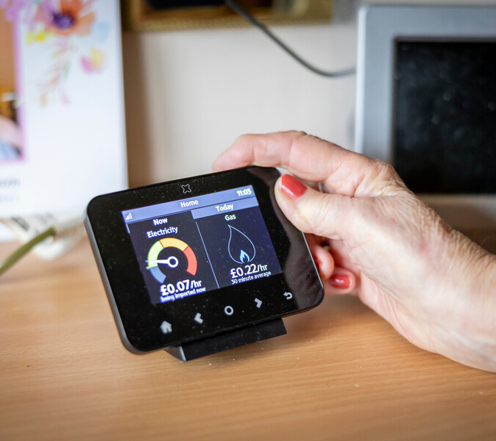
Communicating the network charge
Photo by Age Without Limits

Slide 17



Members’ top priority for the webpage is the total cost for NGN’s charge and its breakdown
17
In a cost-sensitive context with low brand familiarity, Members think customers want clear understanding of how bills are used (to assess value) and reassurance that NGN is properly monitored and funds are used fairly.
Key information to include on the webpage
Why this information is important
Price
Total cost of NGN charges: the most important information about bill charges is how much the NGN portion is, and how stable this price is going forward.
High sensitivity to bill increases. Most unaware and unable to separate energy bills into stable set charges vs parts which fluctuate with the market. It is important to be clear and reassuring about NGN’s fixed portion.
Role
What NGN do for customers: although Members are familiar with NGN, most customers will need a clear succinct summary of NGN's role.
Believe most will be unaware of why NGN are a necessary and important part of the system, having rarely come across them. Unless this is explained, some may be unhappy to learn of the network cost.
VFM
How NGN deliver good value for money: lead with the 24hr safety service (seen as NGN's key offering) and follow with a breakdown of how the charge is spent.
Members want reassurance that their money is being spent wisely, efficiently and on areas that they agree are important such as safety. They want reassurance that their priorities match NGN's priorities for spending.
Trust
How NGN are staying fair, honest and accountable: high-level summary of funding, regulation and comparison to other GDNs. In short – why trust NGN?
Most Members are keen to see reassurance that NGN is regulated and held accountable to high standards without going into too much detail. This could help address institutional mistrust.

Slide 18
Members’ top priority for the webpage is the total cost for NGN’s charge and its breakdown
18
In a cost-sensitive context with low brand familiarity, members think customers want clear understanding of how costs are used (to assess value) and reassurance that NGN is properly monitored and funds are used fairly.
Key information to include on the webpage
Why this information is important
Price
“I feel it doesn't make my blood boil when I see the bill because I now know… when it says standing charge, this is how much you paid for it.”
“Most people look at the bills and they don't look at the breakdown… [the breakdown] is totally irrelevant to the majority of people.”
Role
“They need to show how big the actual organisation is, where the boundaries are and how many households it serves.”
“What does the normal person need to know, and they may need to know more than that [the pie chart]… we find out more as we're here and we discuss it and we're part of the decision-making.”
VFM
“It needs some sort of pie chart, it doesn't show what of that is going into each budget, and I think that's important for people to know.”
“The fact that 55p covers all of that, possibly save your life and continuity of service — not a bad price.”
Trust
“Maybe just a sentence — 'we work with a number of stakeholders including overseas investors, click here if you want any more information’.”
“It helps you to feel like the companies aren’t being greedy and just charging me through the nose.”

Slide 19
Webpage focus point: Price – what is the total cost of NGN charges?
19
Members want to understand the total cost and future stability of the NGN bill portion – especially in a volatile global context.
Struggling but eco-conscious
Interested in cost, but primarily from an affordability and fairness perspective. Want simple, clear explanation of what they’re paying and why.
Engaged & stable
Most likely to engage with detail and read further about how NGN fits into wider system. Want transparency on costs and how investment supports net zero and future energy transition.
What to cover
Total proportion of average energy bill that goes to NGN - £199 or 55p a day perceived as good value.
A link to learn more about total energy bill breakdown.
How stable is the NGN portion, how often does it change and who / what decides if they are increases?
What isn't needed
Detailed breakdown of entire energy bill – can be distracting e.g. why pay VAT? What is green levy?
Details on what costs have to be covered e.g., ‘how network charges are set’ stimulus slide*.
‘How NGN are paid’ – too many organisations involved, ends up being confusing / distracting.
Economic insecurity Economic security
Trust in institutions
Struggling & disillusioned
Highly sensitive to cost, with strong concern about affordability. Want simple reassurance that charges are fair and necessary, and not likely to rapidly increase.
Comfortable but cynical
Likely to scrutinise costs and question whether extra charges (e.g. green levy) are justified. Want reassurance that NGN is not passing on unnecessary costs to customers.
*All stimulus has been included in Appendix 3.

Slide 20
Webpage focus point: Role – who are NGN and why are they important?
20
Members feel wider customers will need a simple explanation of NGN's important role in safe gas distribution.
Struggling but eco-conscious
Unlikely to have a strong understanding of network due to limited headspace. Keen to know the high-level workings of gas supply but generally trust the system to supply safe energy.
Engaged & stable
Reasonably good awareness of the energy system, but some are critical of using natural gas as a fuel. May want to see references to future-proofing or repurposing the network.
What to cover
Who are Northern Gas Networks?
How do NGN fit into the energy network and what is their role? Use simple diagram similar to stimulus*.
Why are NGN important for safe delivery of gas to homes and businesses?
Important to reassure customers who are unfamiliar with NGN that £199 on their bill is going towards an essential service for safe energy supply.
Members already know who NGN are but feel general customers need this info as key context setting.
What isn't needed
Too much detail on suppliers, shippers, producers, and all other parties in the system – this can get confusing.
Economic insecurity Economic security
Trust in institutions
Struggling & disillusioned
Customers not aware of NGN already may react negatively to another corporation ‘taking their money’. Need reassurance that NGN are delivering an essential service and have for many years, even if they were unaware of it.
Comfortable but cynical
May approach NGN’s role and motives with scepticism. Will want a transparent explanation of what NGN does and why it matters for consumers.
*All stimulus has been included in Appendix 3.

Slide 21
Webpage focus point: Value for money – what services do NGN provide for the charge?
21
Members want to feel confident NGN are spending their money wisely on things that match their own priorities.
Struggling but eco-conscious
Sensitive to whether spending feels fair - particularly with the balance between essential services and longer-term or less tangible benefits.
Engaged & stable
Interested in how services support long-term outcomes (e.g. future-proofing). Want to see how investment is aligned with wider social responsibility and net zero.
What to cover
Summary of how the £199 is used for different NGN services – the six listed in the stimulus give good level of detail.
Pie chart* for the proportion spent on each area, to ensure it matches expectations e.g. enough spent on 24/7 emergency service, reliability, and not too much on servicing debt.
Add in social responsibility, seen as positive to ‘give back’ to customers.
What isn't needed
While Members are interested in why NGN takes investment to fund projects and the knock-on impact of repaying, this does not need to be highly detailed.
Customers are sensitive about large borrowing, which poses a challenge for being transparent about investment.
Economic insecurity Economic security
Trust in institutions
Struggling & disillusioned
Focused on whether spending delivers clear, immediate benefits. Sceptical of less tangible areas, want reassurance money is not being spent on areas where customers won’t benefit.
Comfortable but cynical
Likely to scrutinise areas like ‘innovation’ and past investment. Want clear breakdown that demonstrates efficiency and avoids perception of waste / misspending.
*All stimulus has been included in Appendix 3.

Slide 22
Webpage focus point: Trust - How are NGN staying fair, honest and accountable?
22
Members feel it's important to get high-level reassurance on how institutions like NGN have customer interests at heart.
Struggling but eco-conscious
Concerned about whether investor returns come at the expense of customers. Want reassurance that decisions are not just profit driven, and that costs are not disproportionately shouldered by customers.
Engaged & stable
Reassured by explanation of how investment supports safety, reliability and sustainability of the network. Comfortable with the role of investors, but some concern about ethics of private ownership of utilities.
What to cover
Clearly communicate that NGN are held to account through regulation.
Simple overview of ownership using diagram – most only need high level.
Summary of shareholders, their level of influence and background – not too much detail but link to find out more. Transparency of shareholder interests is key for some Members e.g., worried about foreign ownership.
Knowing there is a cap on shareholder dividends is reassuring.
What isn't needed
Overcomplicated explanation of all different levels of ownership.
Complex regulatory jargon – just that NGN must meet Ofgem standards which look after customer interests.
Economic insecurity Economic security
Trust in institutions
Struggling & disillusioned
Instant assumption is that large organisations are taking advantage of the ‘average customer’, so need to be reassured NGN is being held accountable and shareholder interests do not outweigh what is best for customers.
Comfortable but cynical
Critical of ‘big business’ and particularly interested in shareholders and their influence. Also critical that regulation follows government policy, which they may not agree with.
*All stimulus has been included in Appendix 3.

Slide 23




Principles members want underpinning the webpage include ‘clear’, ‘jargon-free’ and ‘visual’
23
Members recognise that customers vary in their appetite for technical detail. Therefore, presenting a clear, visually led main page, complemented by layered links to more in-depth material, is the most effective way to engage everyone.
Visualising concepts
Presenting information visually reduces the cognitive effort required to understand it. Members liked the use of the pie chart and diagrams, also suggesting videos.
Real world analogies (e.g. mortgage comparison with investors) makes concepts relatable.
Plain English / jargon-free
Technical language is seen as a common barrier to understanding the sector.
Industry abbreviations like ‘GDN’ or ‘PSR’ are seen as confusing and unengaging, so should be avoided.
Using plain English aids accessibility and encourages users to engage with the content.
“You need to reduce the amount of jargon terms. Keep it simple.”
“Make it less wordy and more punchy. The more wordy, lengthy information there is, people will get bored.”
Layering of information
Not all users will want the same level of detail – some want a quick overview, while others want to dig deeper.
The main page should be simple and concise with the option to click through, hover over or expand sections.
Clear name and purpose
Users will engage if they can easily gauge its purpose.
Headings and titles should match what a user would look for, e.g. ‘what is the standing charge on your bill?’
Names should be tested – see appendix for ideas.
“They should have the main gist on one page, but then if you're bookish or you want numbers, there's a sub-link that you can click and then go through.”

Slide 24

The Inclusive Panel also emphasise accessibility as a key webpage consideration
24
Given the complexity in communicating the network charge, and the fact it applies to all customers, the Inclusive Panel stress that it’s important that the information is presented in an easy to access way for everyone.
“Don't use big words. Acronyms should be explained in a separate box, on the same page.”
Inclusive Panel Insight:
Accessibility considerations
Alongside endorsing the concepts Workshop Members propose, they also highlight the need to address the following accessibility points…
Adding captions, subtitles and playback speed controls to any video content on the website.
Offering font options and read-aloud functionality on the website.
Partnering with disability charities to co-design accessible formats, and test with people who are hearing or vision-impaired or have low literacy or English skills.
“I’d prefer the pie chart image if you could click in a box and read more about it. Maybe you could click in the box and it says out loud what's on the screen.”
“Partner with a disability charity who can help with how to format it and tell you how to show the information so it’s as accessible as possible.”

Slide 25
Incremental knowledge building is crucial to support meaningful contributions to research.
25
Future research participants would need more detailed information than the average customer might look for.
Principles of communicating during research
Example: Research to assess NGN's value for money
Same as general customer communication
Simple context of NGN’s role in the gas system.
Diagrams and visual presentation of concepts.
Centre around what customers care about and can relate to – e.g., a safe supply of energy.
Plain English / jargon free.
The stimulus* shown in the workshop was felt to be not detailed enough to give a good assessment of value for money.
Research participants need each of the 6 areas broken down into proportions of spending, explained using real-life scenarios and gas system context (for example, comparisons to other GDNs).
Different to general customer communication
More detailed breakdowns and explanations to give enough information to fully comment on.
Bitesize knowledge building and check comprehension after each piece of information.
Alternative scenarios and comparisons to give a meaningful and contextualised choice.
Test with customers before going live.
“Normally there's people like yourself that present it in a way that you're giving us extra information and extra prompts, [that] you won't normally get from just somebody sat reading it. I think the presenter makes it, they make a big difference.”
*The stimulus shown during this discussion is included in Appendix 3.

Slide 26

East Coast Hydrogen Project
Photo by Gordon Williams on Unsplash

Slide 27
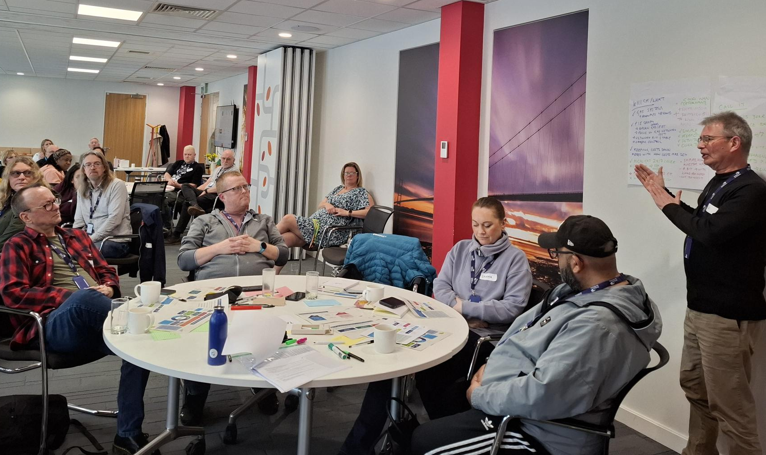
East Coast Hydrogen Project Objectives
Contents
27
27
27
Identify which drivers for the project have the most support from Members
1
1
Identify the public information needs at the ‘FEED study’ stage, exploring preferences on level of information, communication channels and participation methods.
2
Develop principles for future consultation and engagement
3

Slide 28
Attitudes towards the East Coast Hydrogen project are rooted in environmental perspectives, trust in government, cost of living and the appeal of potential benefits
28
It is a more nuanced picture of support than simply seeing those in favour of net zero policies backing the project.
Wider potential converts*
Despite being anti-net zero and anti-government, many find the aspirational and innovative aspect of the project appealing.
This resonates with national and regional pride, which also means they are likely to find opportunities such as energy security, jobs and investments attractive.
Hopeful supporters
Feel that moving away from fossil fuels is important, and trust that this project is a step in the right direction.
View the project as a great way to diversify and bring more innovation to the UK.
Support for ECH project
Anti-net zero
Pro-net zero
Policy rejectors
Do not agree with the project on a principle level, seeing net-zero schemes as an unnecessary financial burden to the country.
Low trust in government furthers their disagreement with the project. They do not trust schemes that are driven by government policy.
Environment-focused critics
Like the ambition behind the project, as they support a move away from fossil fuels.
However, they question the finer details of the project i.e. blue vs green hydrogen and whether this is truly better for the environment.
*Members may be influenced by their high trust in NGN through their panel experience

Slide 29


The aim of innovation unites those with mixed views on net zero ambitions
29
Pride in the UK being at the forefront of innovation can overcome some anti-net zero sentiment.
Pro-net zero
Anti-net zero
ECH project seen as a good way to diversify
UK being a global leader in science and skills
Those with anti-net zero sentiments still feel that innovation is a positive, and that the UK should be pushing boundaries where possible.
Innovation = key positive driver for support
ECH project as a logical move away from fossil fuels
Pride in country, like the ambition
Some nonetheless worry about the distinction between blue vs green hydrogen and if the project will truly be better for the environment.
Strengthening domestic industry
ECH project feels inspiring

Slide 30



Creating jobs and energy security are also seen as key benefits
30
Members believe these aspects could strengthen the broader economy, offering them more security.
Customers are living through tumultuous current events and find the associated benefits of the project that offer security to be the most important.
Creating jobs and investment
Energy security
The opportunity of job creation and retention is seen as the most important benefit - driven by financial and economic concerns.
Jobs and investment are linked to the broader economic improvements which customers are keen to see, given the cost-of-living crisis.
This aspect is appealing to both anti- and pro-net zero Members.
Self-sufficiency is attractive, both due to national pride and the appeal of having control over fuel prices.
Its value is heightened by concerns about the impact the current conflict in Iran will have on energy prices.
Energy security is a benefit that resonates with both anti- and pro-net zero Members.
“The most important one would be creating jobs and investment support.”
“Security first off, because if there's no energy, there's no jobs anyway.”

Slide 31



Despite these positives, perceptions of the ECH project are affected where Members’ mistrust
the longevity of government policies
31
This, plus previous exposure to hydrogen initiatives that have been shelved, means Members are sceptical that this project will come to fruition.
Mistrust in government policy
Exposure to previous hydrogen projects that have been shelved
Primary concern:
Wasted resources
Government involvement
Wasted resources
These Members are concerned about money being wasted if the project was cancelled.
Additionally, Members who recall engagement on the cancelled Redcar hydrogen project, have lower faith that this project could be successful.
These Members want strong justification for the project. NGN will need to emphasise why this project will be different.
Members who have low trust in government reject government driven/backed schemes.
They cite projects such as HS2, as examples of government failures and U-turns that have cost the tax-payer.
“It's a complete waste, but it's more our political system that you know, because they, they start one project and someone else comes in and they start again.”
“Anything that supports the government policy, in my view can go do one. I don't have any faith in government anyway.”
“I don't agree with bankrupting the country on that, on this net zero business, until they actually know what they're doing.”

Slide 32



High cost-of-living also underpins Members’ concerns
32
They worry that customers will ultimately have to pay for this project out of their own pockets.
Members have a variety of financial concerns about the project, especially those feeling most affected by the cost-of-living crisis.
Bill increases
Scale of investment
Members are concerned about eventually having to ‘foot the bill’ by facing bill increases due to the large investment associated with the project.
There is also concern about hydrogen being more expensive than natural gas and the impact this could have on their bills.
Cost concerns resonate with Members across segments. As such, NGN will need to emphasise how other benefits will mitigate this.
Members worry about the large investment being made into this project and question whether the money could be ‘better’ spent e.g. helping vulnerable customers.
This line of questioning is heightened by the sentiment that the cost-of-living crisis has shifted priorities towards finances over environment, as well as doubts that the project will proceed.
“Government and costs increasing…you can’t help but think there’s something on the horizon that we don’t know about.”
“I mean, it's just a waste of money… you could have like a lot more done with £97 million in this country right now.”

Slide 33


There are additional worries about the safety of the project and its environmental impact
33
NGN should focus on mitigating these concerns in a transparent and reassuring manner, as well as making clear which aspects of the project NGN has control over.
Members are concerned about the ECH project, but also more generally about carbon capture and storage infrastructure and hydrogen production.
There is confusion around NGN’s role and remit when it comes to these wider environmental and safety decisions, which NGN will need to communicate clearly on.
Safety concerns
Environmental impact
Members worry about whether hydrogen is truly safe, having heard about its volatile nature.
For some who were unaware of current use of hydrogen, hearing examples of where it was already in use helped reduce safety concerns.
Members question the use of blue vs green hydrogen, and the impact these options have on the environment (including if they will really be beneficial).
They also have concerns about the practicalities and environmental impact of carbon capture.
For those living near the planned route, these concerns intensify, accompanied by broader anxieties about local disruption.
“It's also incredibly dangerous…it would explode.”
“I don't understand what's going to happen with this carbon. Yeah, all right, it can be stored, but there's only so much you can store. And for how long?”

Slide 34





NGN can use the identified drivers of support for the project to help mitigate concerns
34
Concerns
Benefits
What this means for NGN
Large investment
Creating jobs and investment
Members worry about the scale of investment.
Mitigation could involve focusing on the key perceived benefit – creating jobs and investment - including reassurance that this is an opportunity for the broader economy.
A major concern for Members is that resources will be wasted if the project is cancelled. The key to mitigating this will be emphasising the need for innovation, and for the UK (and the North-East specifically) to lead on this. Arguments such as the re-using of the pipework can also help mitigate frustrations over wasted resources.
NGN should avoid using government policy as the key rationale for the project, as this increases risk of rejection at a principle level.
Support for the project could be further influenced by emphasising the importance of energy security during uncertain times.
Wasted resources,
government policy changing
Innovation & Energy security
To mitigate safety concerns, NGN needs to demonstrate examples of how hydrogen is currently being used safely and what safety measures will be put in place. They also need to emphasise its use for industry and not domestic settings – an argument which also helps distinguish this project from previous ones which did not go ahead.
The ultimate aim of moving towards greener energy speaks to net zero supporters. Where there are environmental concerns, NGN must clearly communicate about the limits of their role and remit in these decisions.
Safety concerns & environmental questions
Moving towards greener energy

Slide 35
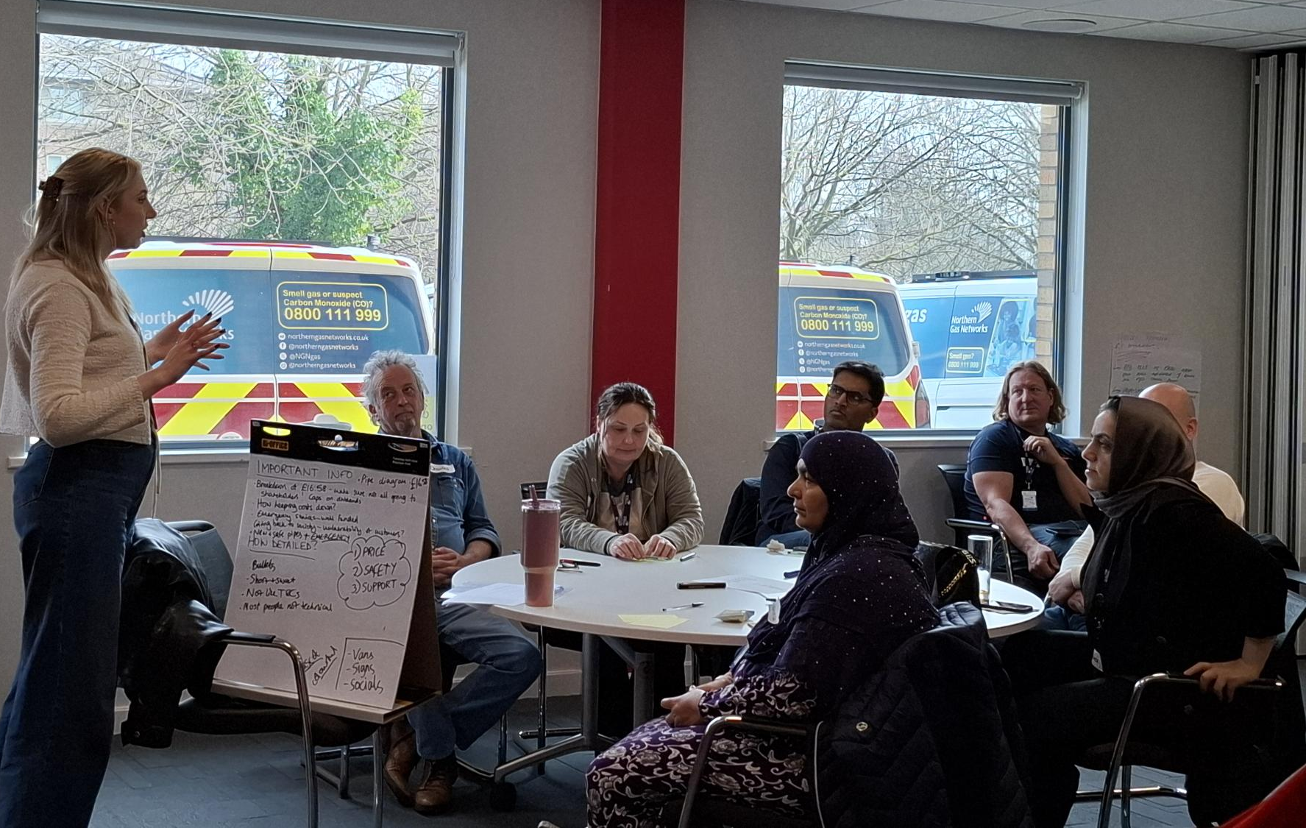
East Coast Hydrogen Project Objectives
Contents
35
35
35
Identify which drivers for the project have the most support from Members
1
1
Identify the public information needs at the ‘FEED study’ stage, exploring preferences on level of information, communication channels and participation methods.
2
3
Develop principles for future consultation and engagement

Slide 36


Members’ perceptions of the ECH project impact their engagement preferences
36
Those sceptical about fluctuating policies would like light touch consultation, in contrast to those actively opposed to the project.
Sentiment
Impact
David*: Frustration with the system.
David has watched major infrastructure investments get approved, funded and quietly shelved.
He believes the costs of these decisions are then passed on to customers, who absorb the biggest impact via increased bills. This has lowered his trust in government-backed projects, feeling that government positions change too frequently to be relied on.
As a result, David believes the project would be too susceptible to change at the FEED stage for anything beyond light-touch engagement to be appropriate.
Sceptical about project coming to fruition
Preference for limited engagement at FEED stage given the project is still highly susceptible to change/being shelved.
Peter*: Net zero scepticism.
Peter has major concerns over the East Coast Hydrogen project relating to both safety and perceived mismanaged spending. He is sceptical of net zero projects and does not think the benefits of this project outweigh the risks.
He believes investment would be better spent supporting customers who are facing hardship because of the cost-of-living crisis.
Peter believes that consultation at the FEED stage should be more in-depth to allow for customer scrutiny regarding the project. He feels that if enough customers voice their objections that the project will be reconsidered.
Preference for more in-depth engagement at FEED stage to have time to input their perspectives and stop the project if necessary.
Opposed to project
* Pseudonyms used for the purposes of reporting

Slide 37






Members expect the FEED stage to inform customers about the project at a high level
37
They want justifications for the project, as well as information about cost.
FEED
DCO
Information needed at FEED stage:
Justification for the project including key benefits, how this compares to past projects, and importantly why this one is different. This is perceived to combat negative feelings from past project consultation e.g. Redcar.
High-level summary of the cost and the locations likely to be impacted, caveated with transparency that this is subject to change, to manage expectations.
Desired engagement approach at FEED stage:
Members feel that the primary goal of FEED should be to inform customers of the project (e.g. via leaflets), before undertaking consultation ‘in earnest’ at the DCO preparation stage.
If NGN feels that more detailed engagement is meaningful at this stage, it should be gained via controlled, informed settings such as a citizen panel.
Desired engagement at DCO stage:
Panel Members would expect the DCO stage to be a two-way conversation, in contrast to the one-way ‘inform’ level of engagement wanted at the FEED stage.
They expect social media and postal engagement, as well as deliberative workshops and public meetings.
Those being consulted should have very clear direction regarding what they can give input on, and for experts to give clear justifications for choices made as the consultation continues.
“I'm not sure we need to consulted yet. We need to be educated and told about it.”
“I think as a business you need to be careful about what you put out, if it's not certain. Because people get annoyed or cling on to things, or can lead to a lot of miscommunication, misunderstanding. So, I think its about finding the balance - you don't literally need to tell us everything.”

Slide 38
Thinking about who to inform, Members place importance on reaching people who live or work near the potential route
38
It is also important for stakeholders to be informed, while informing the wider public is less important.
Q. Thinking about the East Coast Hydrogen Project, at the FEED stage (not Development Consent Order/ Planning Application stage), how important is it to you, if at all, that NGN informs:
“Just announce that there is a project… and don't go into nitty-gritty because you're going to waste your time if it's not going to go ahead anyway.”
Base: 31 Workshop Panel respondents (question not asked of Inclusive Panel)

Slide 39




Key principles for consultation at the FEED stage
39
Transparency is seen as most important, alongside accessible, targeted and meaningful engagement.
Transparent
NGN should be as transparent as possible around the cost of investment and the locations impacted, while clearly indicating which current information is subject to change.
NGN should also make it very clear how much, if any, input customers can have.
Accessible
Information should be accessible, utilising multi-channel methods e.g. online and offline.
Targeted
Targeted engagement should be implemented with communities close to the pipeline and industrial sites.
Engagement should be light touch – informing rather than consulting.
Meaningful
Any consultation should lead to meaningful decisions based on customer feedback and avoid ‘lip service’.

Slide 40

Appendix
Photo by Nick Fewings on Unsplash

Slide 41

Appendix
Contents
41
41
41
Sample breakdown
Member feedback
Additional insights and stimulus: Network charges
Additional insights and stimulus: East Coast Hydrogen
1
2
3
4

Slide 42
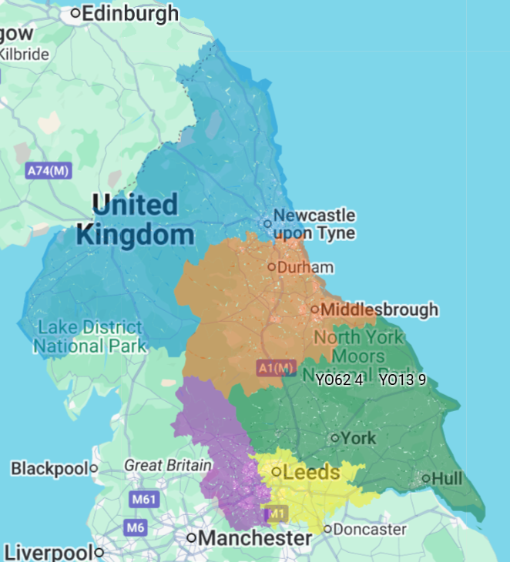

Workshop Panel sample demographics: March 2026
42
18-29: 13%
30-44: 23%
45-59: 37%
60+: 27%
Female: 57%
Male: 40%
Non-binary: 3%
37%
White British: 63%
Asian/Asian British: 20%
African: 3%
Mixed/multiple ethnic groups: 3%
Other ethnic group: 3%
Prefer not to say / self describe: 6%
20%
Micro/Small business owners (NHHs): 3
43%

Slide 43
Workshop Panel sample demographics: March 2026
43

Slide 44
Workshop Panel sample demographics: March 2026
44

Slide 45
Inclusive Panel sample demographics
45
Gender | Male | 3
 | Female | 7
Age | 18-29 | 2
 | 30-44 | 4
 | 45-59 | 2
 | 60+ | 2
Ethnicity | White British | 8
 | Asian / British Asian | 2
PSR status | Registered on PSR | 6
 | Not registered on PSR | 4
SEG | ABC1 | 8
 | C2DE | 2
 | Mental health disability | Physical disability | Cognitive disability | Sensory disability | Long-term health condition
1 |  |  |  |  | X
2 | X
3 |  | X |  |  | X
4 |  | X | X | X | X
5 |  | X
6 | X |  |  |  | X
7 |  | X |  | X | X
8 |  | X
9 |  | X |  |  | X
10 |  | X

Slide 46
Appendix
Contents
46
46
46
Sample breakdown
Member feedback
Additional insights and stimulus: Network charges
Additional insights and stimulus: East Coast Hydrogen
1
2
3
4

Slide 47

Feedback from participants mainly focused on logistics, with the vast majority happy with the content and format of the workshop
47
Members continue to express high levels of satisfaction
“Nothing. All the staff were exemplary, as was the planning.”
A large proportion responded with ‘nothing’ or ‘all good’ when asked about points to improve, feeling content their previous feedback have been acted upon.
The flow of the day and catering was positively received, with some clearly noting the format is working well and no need to ‘fix what isn’t broken’.
“Room quite noisy until we all went off into our breakout groups. Maybe new Members should be introduced to gain a different prospective. Some people on the panel had been there for 8 years.”
Suggested improvements centre around practical logistics
A few wanted a more conveniently located hotel to make transport into the city and railway station easier.
A minority of improvements focussed on logistics on the day, including bigger fonts, noise control, more screens, seats facing screen.
A minority also mentioned provision of a higher incentive, a certificate of attendance, and better renumeration for those travel by car.
“The screens - only 1 screen worked after second topic so couldn’t see from afar.”

Slide 48
While the proportion of those very satisfied has reduced, Wave 3 saw 100% satisfaction with the event and speakers for the first time
48
How satisfied were you with…?
Base: All Wave 1 workshop attendees (33); All Wave 2 workshop attendees (32); All Wave 3 workshop attendees (30)
The speakers | The content | The event

Slide 49
Satisfaction with time for discussions and event accessibility has increased
49
To what extent do you agree / disagree with the following…
Base: All Wave 1 workshop attendees (33); All Wave 2 workshop attendees (32); All Wave 3 workshop attendees (30)
Sufficient time was allowed for discussions
I was provided with enough information
The information provided was easy to understand
The event was accessible
3%

Slide 50
Sentiment towards NGN engagement remains highly positive
50
To what extent do you agree / disagree with the following…
Base: All Wave 1 workshop attendees (33); All Wave 2 workshop attendees (32); All Wave 3 workshop attendees (30)
NGN designs engagements in a way that makes me feel involved and heard
NGN is honest about its future choices and what my engagement will influence
NGN engagement is a good use of time and money

Slide 51
Vast majority continue to agree NGN provides clear information, explains how feedback is used, and allows them to feedback on what interest them most
51
To what extent do you agree / disagree with the following…
Base: All Wave 1 workshop attendees (33); All Wave 2 workshop attendees (32); All Wave 3 workshop attendees (30)
NGN makes it clear how it has used its feedback to change its business plans
NGN provides me with clear information
NGN enables me to give feedback on the topics that interest me most

Slide 52


In future workshops, Members want to have more discussions with NGN about the future of the gas network
52
Future plans with hydrogen
Consumer advice
Members enjoyed the discussion on the East Coast Hydrogen project.
They want to explore the future of hydrogen infrastructure, and the choices NGN faces in the near term with hydrogen.
The future of energy and hydrogen were the most popular suggested topics.
Members want to help NGN with how it communicates support schemes and consumer advice to the customer base.
Energy prices and providing help for vulnerable customers were flagged as specific topics worth discussing at a future workshop.
“I think the Hydrogen topic could be explored a bit more, l saw a TV programme which said it’s not economic to continue with this, l was left a bit confused.”
“More on how to help the vulnerable, like pensioner's, people with disabilities, and unemployment.”

Slide 53
Appendix
Contents
53
53
53
Sample breakdown
Member feedback
Additional insights and stimulus: Network charges
Additional insights and stimulus: East Coast Hydrogen
1
2
3
4

Slide 54
Members place greater trust in gas networks like NGN than in other actors in the energy sector
This confidence does not extend to all institutions - particularly the government, where scepticism remains very high.
Q. To what extent do you trust each of the following to act in the best interests of energy consumers?
“NGN are ethical, they do go over and above with what they're trying to do.”
“The people that are running this country don't have any idea of anything, and they're running it into the ground. It's awful.”
Base: 31 Workshop Panel respondents (question not asked of Inclusive Panel)

Slide 55
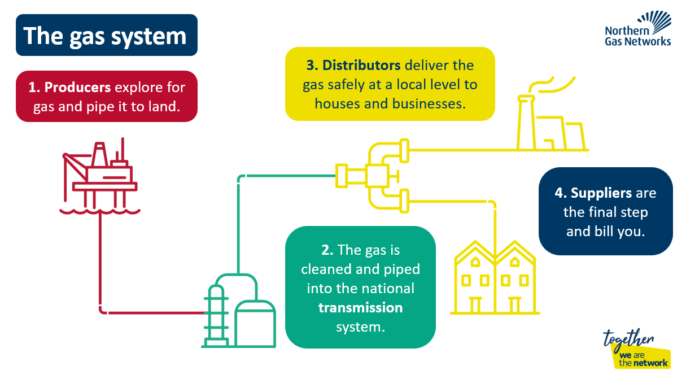
Network charge stimulus

Slide 56
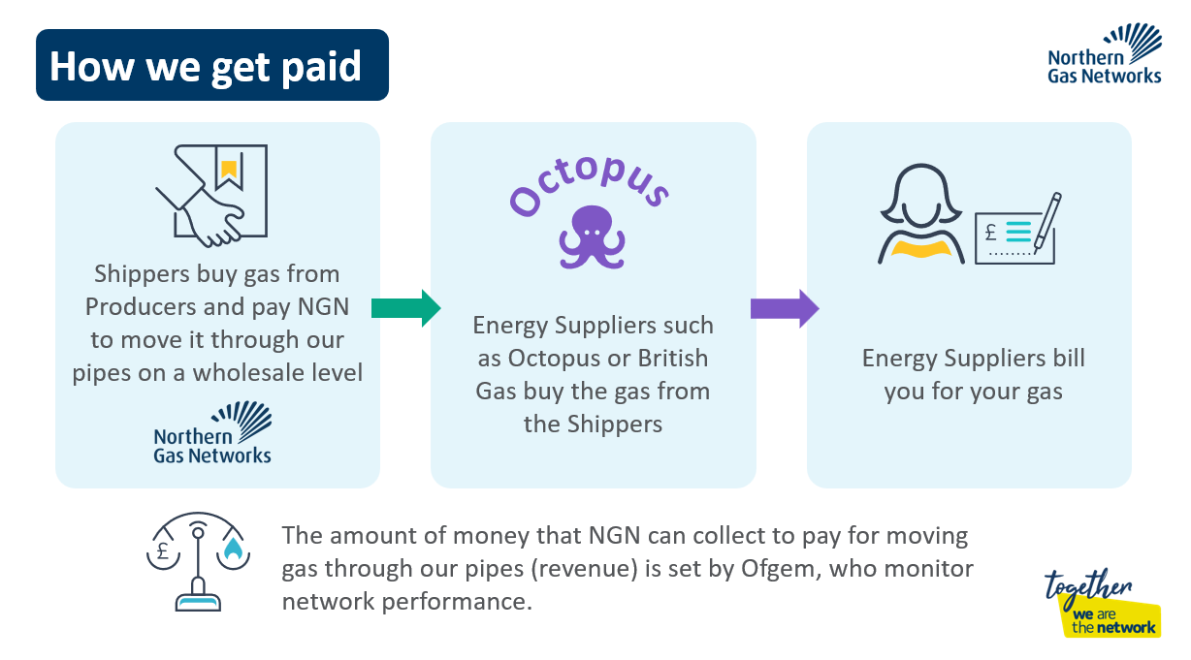
Network charge stimulus

Slide 57
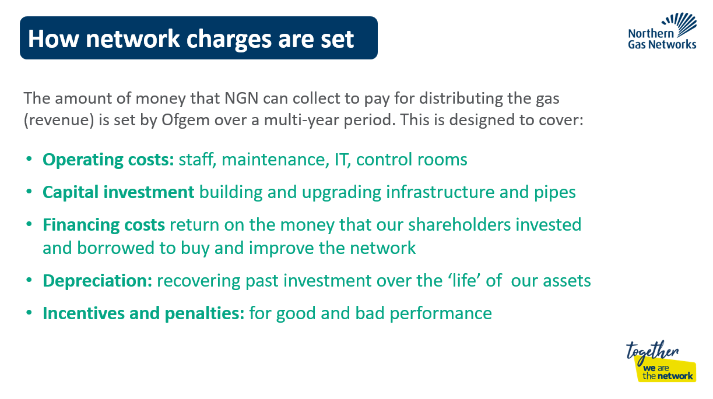
Network charge stimulus

Slide 58
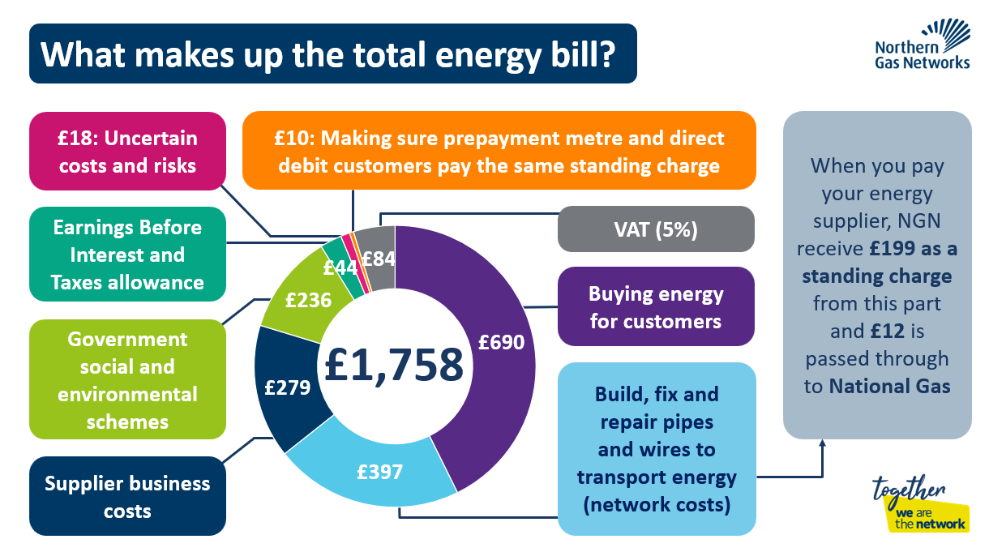
Network charge stimulus

Slide 59
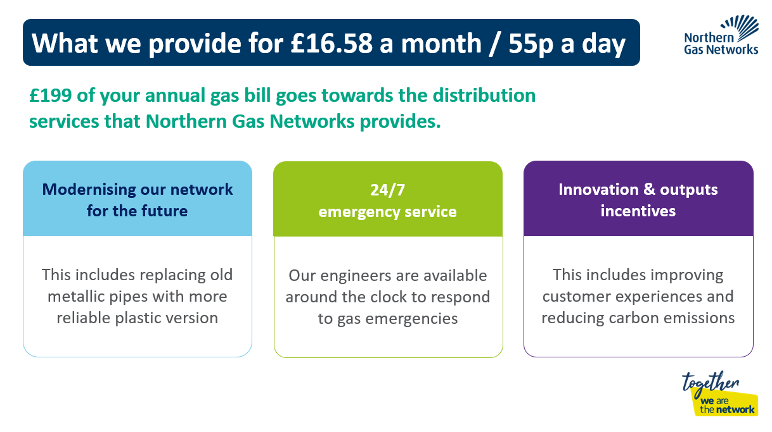
Network charge stimulus

Slide 60
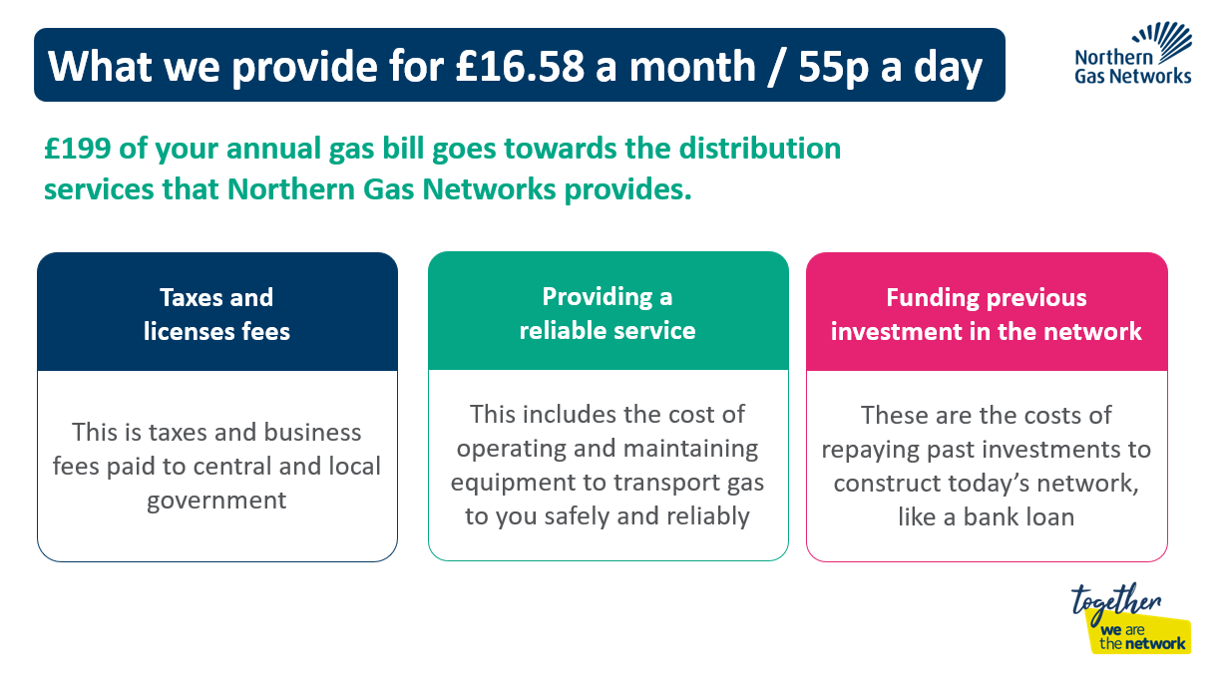
Network charge stimulus

Slide 61
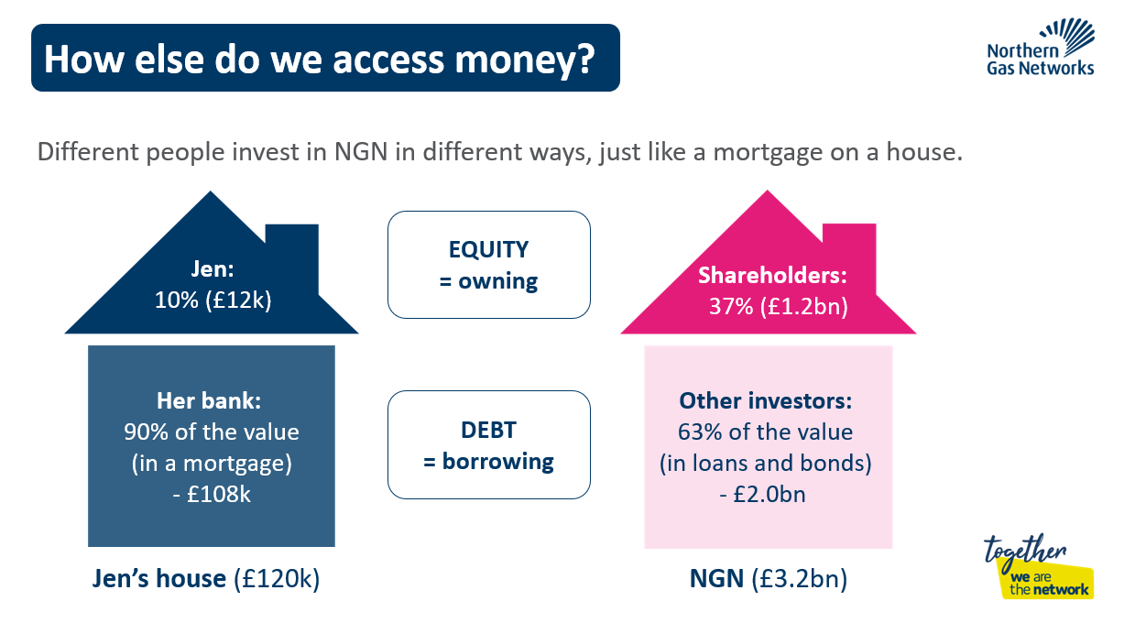
Network charge stimulus

Slide 62
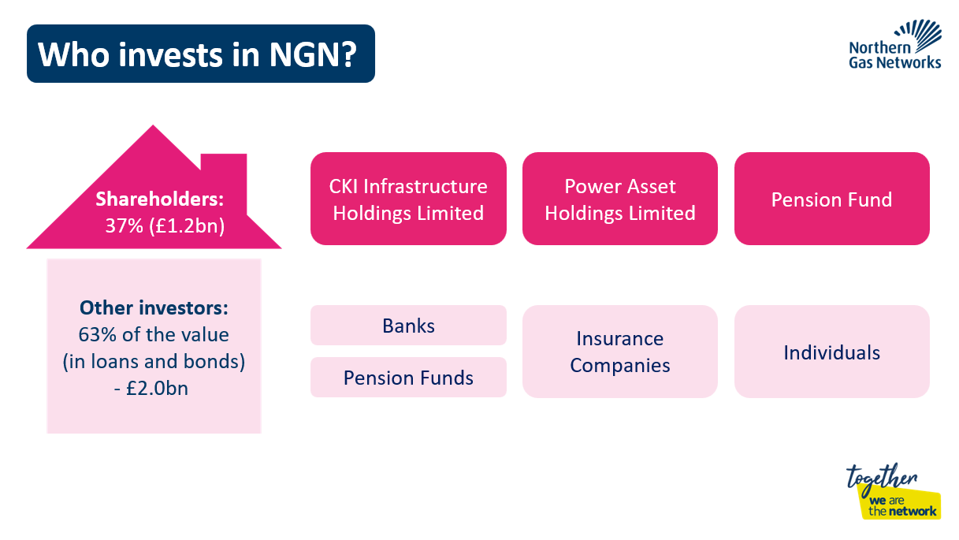
Network charge stimulus

Slide 63
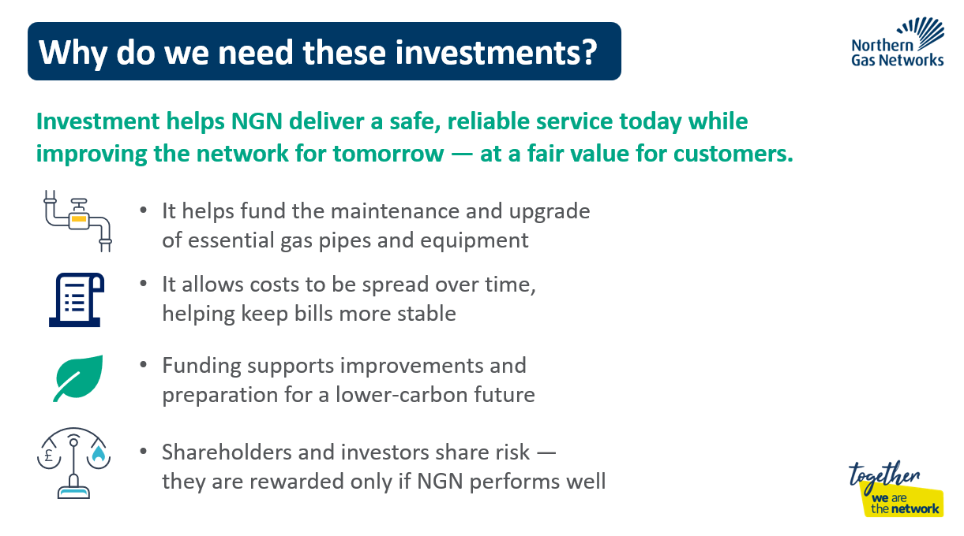
Network charge stimulus

Slide 64
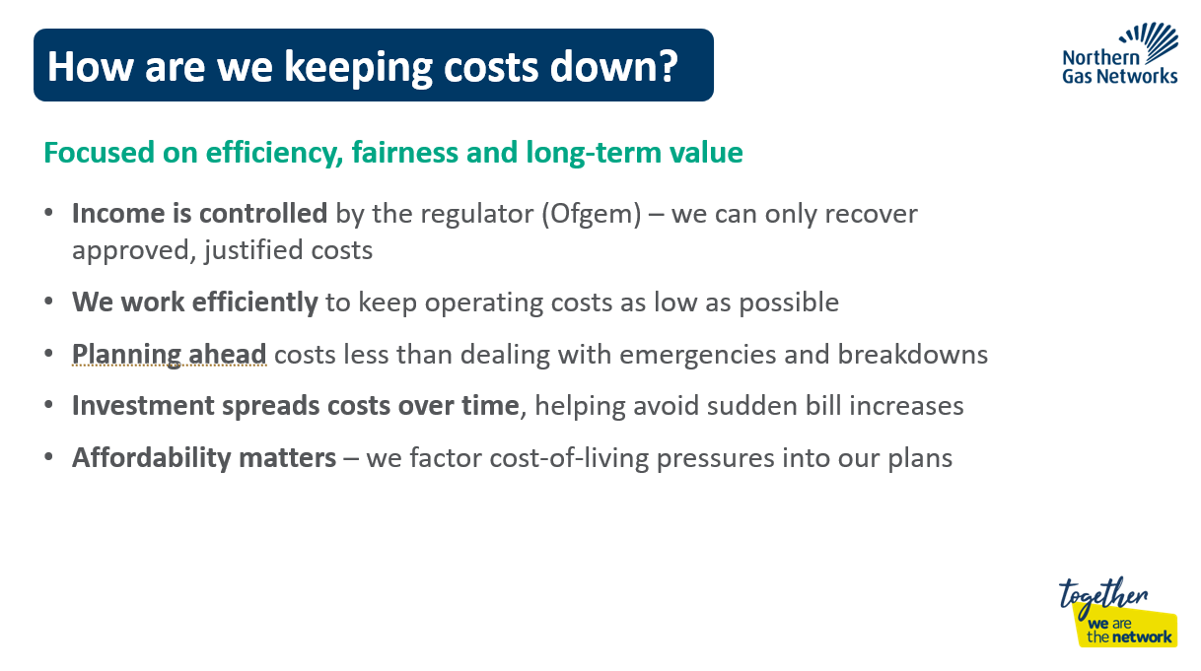
Network charge stimulus

Slide 65
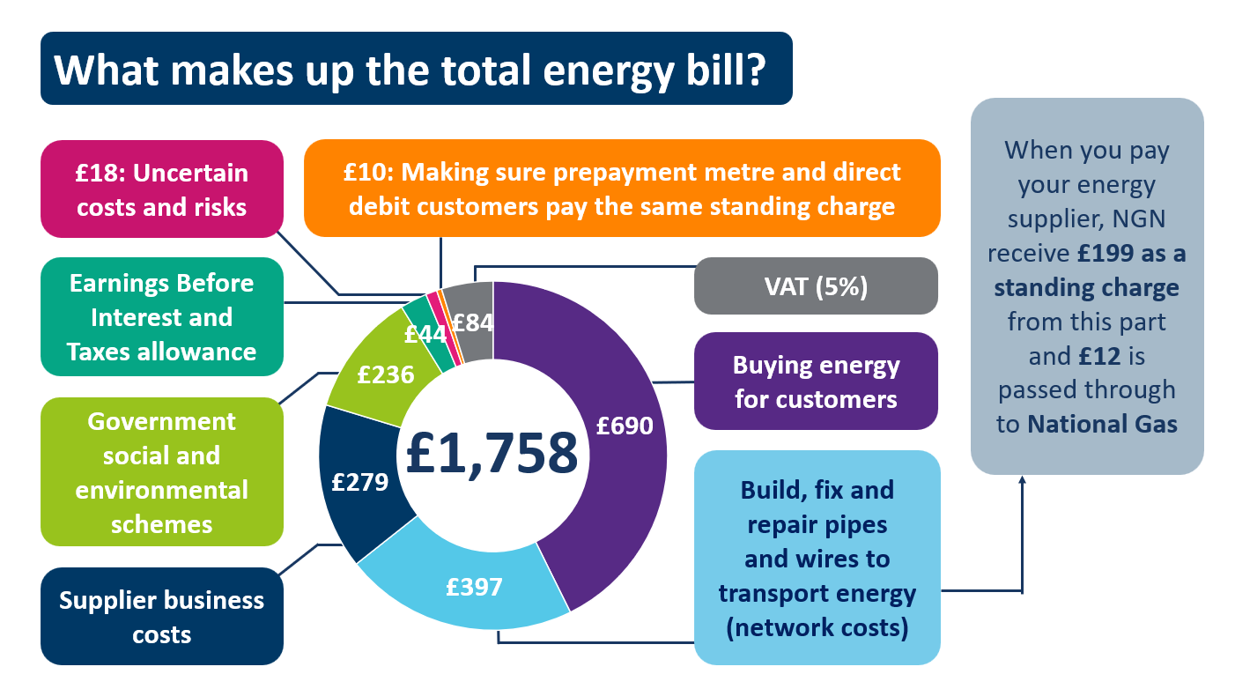
Members have a range of questions about the overall energy bill and gas system
There are questions that don’t relate to NGN's specific portion of the bill but are top of mind for Members, to the point where it could derail their engagement with the NGN billing.
Energy bill-related questions:
Why do energy bills charge VAT?
What is included in the 'green levy' portion?
Would the energy sector be better off nationalised?
What are 'uncertain costs'?
Would gas be cheaper if we drilled more in the North Sea?
NGN-related questions:
Why is the gas system split into regions?
Why are there so many organisations involved – shippers, producers?
Do shareholders make day-to-day decisions?
Why does NGN borrow so much money?
When did NGN charge last go up or down?
Why are there so many NGN road works at the moment?

Slide 66
Members had a range of ideas for web page name that could be tested
Most felt it was important for NGN to consider the purpose of the web page and then test with customers.
Principles for naming
Clearly explain purpose of the page
Simple language
Short title
Ideas for webpage name
Test and develop
Ultimately, Members feel this should be developed by the comms team and tested with customers once there are a range of options
“It would be easier if you came up with some ideas and said, look, this is what it could be, and then we can say, well, actually no.”
Your NGN bill made simple
What makes up your bill
Your NGN bill
About our product
What is your standing charge?
What price for peace of mind?
What do I get for 55p a day?
Where does my bill go
How your bill is made up
Get to know your bill
What NGN is doing with your money
Know your network
Customer benefits

Slide 67
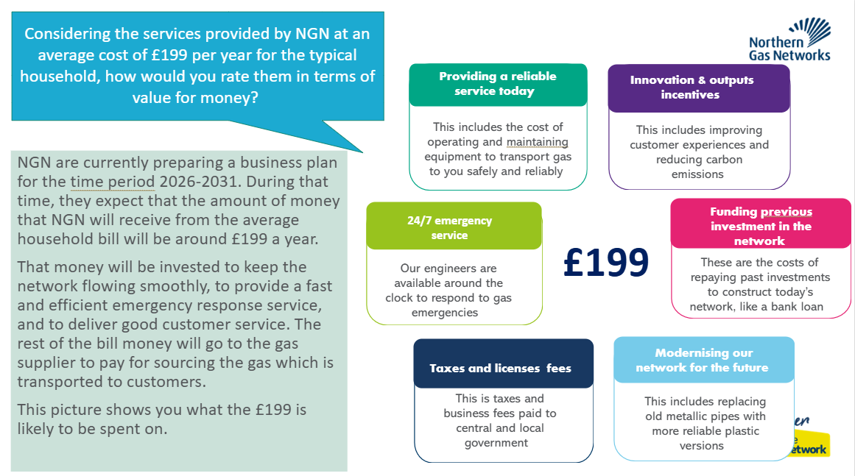
Further member reflections on the network charge stimulus for research participants
Members were asked to discuss whether the information below would be enough for new research participants to assess whether NGN offer value for money.
“It should be an interactive diagram. A static image is a bit old school.”
“You need to have the supporting evidence to back up what it is that you're saying.”
“Would you put the percentages against the £199 in there, or would you put it in money terms?”

Slide 68
Appendix
Contents
68
68
68
Sample breakdown
Member feedback
Additional insights and stimulus: Network charges
Additional insights and stimulus: East Coast Hydrogen
1
2
3
4

Slide 69
A majority of panel Members have heard something about hydrogen currently being used as a fuel prior to this wave
69
Q. Before the workshop, how much would you say you knew about hydrogen already being used as a fuel in some industrial processes in the UK?:
Base: 31 Workshop Panel respondents (question not asked of Inclusive Panel)

Slide 70
A majority of panel Members have heard something about hydrogen being used as a fuel in the future prior to this wave
70
Q. Before the workshop, how much would you say you knew about the potential future uses of hydrogen to reduce emissions in some industries?
Base: 31 Workshop Panel respondents (question not asked of Inclusive Panel)

